Slide 1

Understanding World.cs

Slide 2
What does static mean?

Slide 3
Static
Static members
Constructors
Fields/properties
Methods
Static classes

Slide 4
Static members
A static member belongs to the class rather than to a specific object/instance of the class
In other words: You do not need to create an instance of a class to use it
Class
Objects
class Person
public static int MaxAge = 120;
public static int TotalPeople;
public string Name;
public int Age;
public void Introduce (int key)
public static string GetTotalPeople()
person1
Name: “Alice”
Age: 25
shared
person2
Color: “Bob”
Age: 18

Slide 5
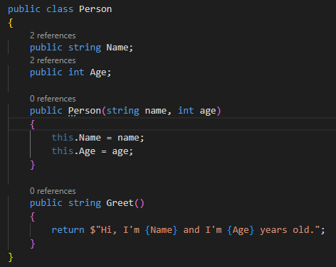
Add static members to Person

Slide 6
Static classes
A static class cannot be instantiated.
You access the members of a static class by using the class name itself.
Example: a static UtilityClass with static MethodA is called using UtilityClass.MethodA()
A static class can be used as a convenient container for sets of methods that just operate on input parameters and do not have to get or set any internal instance fields.
For example, in the .NET Class Library, the static System.Math class contains methods that perform mathematical operations
From: https://learn.microsoft.com/en-us/dotnet/csharp/programming-guide/classes-and-structs/static-classes-and-static-class-members

Slide 7
Create a static class
Create a Person Factory class that generates John Doe and Jane Doe instances with a random age (from 0 up to the MaxAge defined in the Person class)

Slide 8
define values that cannot be changed
What does const and readonly mean mean?

Slide 9
Unchanging data: const vs readonly
const | readonly
Can be only be value types (int, char, double, bool, string, enum) | Can be any type
Must be initialized at the declaration of the field | Can be initialized either at the declaration or in a constructor
Are implicitly static (you don’t need to use static keyword) | Can use the static keyword or leave it out
Value must be known at compile time | Value can be determined at run time

Slide 10
When to use const vs readonly
const
readonly
The value belongs to the class
AND
The constant is a value type (int, char, double, bool, string, enum)
The value belongs to the object
AND/OR
The value is a reference type

Slide 11
static readonly
What do you think this means?

Slide 12
static readonly
Used to declare a static field (field that belongs to the class) that will not change after it has been initialized
... But isn’t this the same as a const?

Slide 13
When to use const vs static readonly
const
static readonly
The value is known at compile-time
So no method calls etc
AND/OR
The constant is a value type (int, char, double, bool, string, enum)
The value is determined during run time
So unknown value until code is run
AND/OR
The value is a reference type

Slide 14
Exercise 1
Open the file Car.cs in Teams
(OODP>Files>W03_01 static const readonly > Starter Code)
Make sure you understand the class
Ask questions if not!
Look at the data associated with a Car and determine if you need to add
nothing,
static,
const,
readonly, or
static readonly
Add a static method that takes in 2 cars and evaluates which is faster. Remember to consider null Cars.

Slide 15
Exercise 2
Create a CarFactory class that cannot be instantiated which stores the top speed of a Fiat (200) and a Bugatti (420).
The class should be able to produce blue Fiats and red Bugattis using the stored top speeds

Slide 16
You should now understand World.cs

